Slide 1

Fienberg-Fisher K-8 Center
Parent Orientation 2015-2016
Maria P. Costa, Principal
Aisha V. Marrero, Assistant Principal
Mary Murphy, Assistant Principal

Slide 2

ABSENCES:
  If your child must be absent from school, please send a written note from you and/or doctor upon your child’s return to school in order for the absence to be excused. For your convenience, we have a form in the main office.
EXCUSED ABSENCES:
  Sickness,
  Death in the family (three days only),
  Doctor or dental appointments and
  Religious holidays.
  Absences for any other reasons are not excused.

Slide 3

TARDIES: a student is considered tardy after the 8:35 a.m. morning bell rings for students in grades 2-8 and after 8:20 a.m. for students in grades PK-1 and 8:15 a.m. for HeadStart.
Please synchronize your clocks/watches to match the school time.
Remember that excessive absences/tardies may be cause for disciplinary action including: detention, suspension, loss of incentives, referral to the Attendance Review Committee and other agencies.

Slide 4
PERFECT ATTENDANCE: Students who are present every day, AND do not have more than 4 tardies at the end of the school year will be eligible to receive “Perfect Attendance” incentives.

Slide 5

There will be absolutely NO STUDENT DROP-OFF BEFORE 7:30 a.m.
Supervised Before School Care is NOT available.
  PK-Headstart Classrooms/Portable
  KG - 2 Cafeteria
  3 - 5 Hardcourt
  6 - 8 Children of the World Park

Slide 6

Teachers will pick up their classes from the cafeteria at 8:15 a.m. (KG-2), and from the court at 8:30 a.m. (3-5 grade). Middle School students will go upstairs at 8:30 a.m.
Students reporting after their designated time, must go to the main office to obtain a late pass. PARENTS MUST ACCOMPANY STUDENTS IN GRADES PK-1.

Slide 7

• Please do not enter inside any of the school’s parking lots to drop off/pick up your children. Parent/Visitors parking lot is located behind the gym.
  • Safe Drop Zones: Drexel Avenue Circle
  • Pennsylvania Avenue
  • Washington Avenue, if you are walking or riding a bicycle.
  For the safety of our students please exit the school once you have dropped off/picked up your children.

Slide 8

Students who ride bicycles and/or scooters to school must park and secure them in the bicycle racks provided near the cafeteria or near Pennsylvania Avenue.
Under no circumstances should bicycles and/or scooters be secured/chained to the perimeter fences, street signs, parking lot signage, nor taken into the classrooms due to safety to life issues.

Slide 9
Students who ride bicycles and/or scooters to school must park and secure them in the bicycle racks provided near the cafeteria or near Pennsylvania Avenue.
Under no circumstances should bicycles and/or scooters be secured/chained to the perimeter fences, street signs, parking lot signage, nor taken into the classrooms due to safety to life issues.

Slide 10

Please join your child in our Panda Cafeteria every morning.
Free breakfast is served for students from 7:30 a.m. to 8:15 a.m. only.
Please be aware that breakfast will not be served after 8:15 a.m. unless the students ride on the M-DCPS buses and those buses arrive late.

Slide 11

People can bully by hitting. They bully by talking. People who are bullied can be sad, lonely and sometimes mad.
We don't allow bullying at our school. We don't allow it on the school bus. And if someone is bullying your child outside school we want to hear about that, too.
If your child sees someone else being bullied – encourage them to speak up and not just stand by and do nothing.
Report it!

Slide 12

Parents/Students can leave a note in the Bully Box.
You can go online to the parent/student portal.
Or you can call the bullying hotline at
305-995-CARE.
We all have to do our very best to keep our school safe.

Slide 13

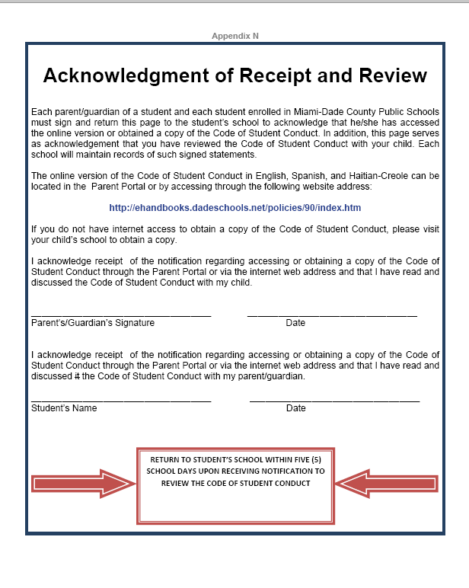
CODE OF STUDENT CONDUCT: is designed to maintain a safe and positive learning environment.
You can access in the following link – Student Portal
http://ehandbooks.dadeschools.net/policies/90/index.htm

Slide 14

Parents are required to pick up students at the time of dismissal.
Students in grades PK-K will be dismissed from their classroom. All students in grades 1-8 will go to the Children of the World Park to wait for parents following dismissal and/or to the designated dismissal area (after school care, etc.)
Fifteen minutes after dismissal, any student who has not been picked up, will be taken to the Fienberg Office to call home.
Parents will be required to sign-out late pick-up and will be reminded of school hours.

Slide 15

Continuous violations/offenses may be caused for disciplinary action and/or referral to the after-school care program and/or other agencies.
Students in tutoring/after school programs, clubs or detention will meet outside the assigned classes.
All other students are to leave school grounds immediately after dismissal.
Students will walk with teachers to designated exits.

Slide 16

We are a Mandatory Uniform School.
Uniform Colors – Elementary (PK-5)
Red or Navy Blue Polo Shirt with school emblem
Khaki bottoms

Slide 17

Middle School Colors (6-8)
White or Black Polo Shirt with school emblem
Khaki bottoms
DENIM JEANS ARE NOT PART OF OUR UNIFORM POLICY.

Slide 18

ELECTRONIC DEVICES: such as MP3 Players, ipods, iphone, ipads, NintendoDS, CD Players, tape recorders, and/or any toys to include trading cards, and any other personal belongings are not allowed at school and should be left at home.
We are not responsible nor do we investigate if any of these items get lost or stolen.
If any student is found with any of these items, the item will be confiscated by the teacher or other personnel and submitted to an administrator for parent pick-up.

Slide 19

CELLULAR PHONES:
Must be turned off during school hours.
If phones are activated or cause any disruption, they will be confiscated by the teacher or other personnel and submitted to an administrator for parent pick-up.
WE DO NOT INVESTIGATE AND WE ARE NOT RESPONSIBLE FOR LOST OR STOLEN CELLULAR PHONES.

Slide 20

Fire Drills will be conducted once a month.
Students and any visitor in our building will walk in a quiet and orderly manner to the designated/nearest exit.
Please remain outside in quiet lines until the principal and/or the assistant principal give visual indication that you should return to their classrooms.

Slide 21

During the first week of school, your child will be taking many forms home. Please sign and return all of these to your child’s teacher.
Emergency Contact Card – Complete/Sign/Return
Code of Student Conduct – Complete/Sign/Return
Media Release – Complete/Sign/Return
Procedures – Complete/Sign/Return
Agenda – Complete/Sign/Return
Responsible Use of Technology – Complete/Sign/Return

Slide 22

Title I Migrant Education Program Survey – Complete/Sign/Return
Accident Insurance – Online
Lunch Application – Online

Slide 23

Grades reflect a student’s academic performance as compared with norms that are appropriate for the grade or subject.
  A 90 – 100 Outstanding
  B 80 - 89 Good
  C 70 – 79 Satisfactory
  D 60 – 69 Improvement Needed
  F 59 – or below Unsatisfactory

Slide 24

Grades indicate the teacher’s evaluation of a student’s effort in the instructional program;
These grades are independent of academic and conduct grades.
  An effort grade of "1" indicates outstanding effort on the part of the student.
  An effort grade of "2" indicates satisfactory effort on the part of the student.
  An effort grade of "3" reflects insufficient effort on the part of the student.

Slide 25

Grades are used to communicate clearly to both students and parents the teacher's evaluation of a student's behavior.
These grades are independent of academic and effort grades.

Slide 26

Regular, purposeful home learning assignments are an essential component of the instructional program at our school.
Home learning will be regularly assigned and reviewed by teachers Monday through Friday.
All students must read 30 minutes a day, at home, at their independent level.

Slide 27

We are an IBO World School in both the Primary Years Programme (PYP) and in our Middle Years Programme (MYP)
The International Baccalaureate Organization (IBO) aims to develop inquiring, knowledgeable and caring young people who help to create a better and more peaceful world through intercultural understanding and respect.

Slide 28

Within the PYP it is believed student learning is best done when it is authentic – relevant to the “real” world.
This year we will be reevaluated.
  Please attend parent meetings – Parent Calendar
  Ask your child about IB
  If you have any questions or would like to help please contact our IB PYP Coordinator at ycardoso@dadeshcools.net or 305 531 0419 ext. 2121

Slide 29

The Florida State Standards provide a consistent, clear understanding of what students are expected to learn, so teachers and parents know what they need to do to help them. The standards are designed to be robust and relevant to the real world, reflecting the knowledge and skills that our young people need for success in college and careers. With American students fully prepared for the future, our communities will be best positioned to compete successfully in the global economy.

Slide 30

Students who lose or damage a textbook or library book must pay for the loss.
Any damage done to school equipment or property by a student will also be paid for by the student.

Slide 31

Full priced lunch is $2.25 for students in PK-5 grade and
$2.50 for students in grades 6-8.
Milk will be available a la carte for those who bring a packed lunch.
Please complete applications online for the free or reduced lunch program at: http://nutrition.dadeschools.net/

Slide 32
Please make sure you complete online.
If you qualify, you will receive free/reduce lunch
In an emergency: A peanut butter sandwich and milk will be provided for students without lunch money or an approved lunch application.

Slide 33

If your child has an accident, please encourage him/her to tell their teacher immediately.
The teacher will send the child to the clinic if needed or will get help. (Make sure your child is registered in the clinic to receive free services).
The teachers will complete an accident report for your child’s safety and will notify you.
Student insurance at a low cost is available, we encourage you to purchase it for your child. The forms will go home the first week of school.

Slide 34

Parents, students and relatives are encouraged to sign up and become active participants in the Parent Teacher/Student Association (PTSA).
The cost is $5.00 per year.
The PTA helps the students with field trips, uniform vouchers, parties, graduation and events.
We need to support our PTA!

Slide 35

ALL volunteers/chaperones MUST be cleared through M-DCPS.
You CANNOT volunteer in your child’s class, BUT you are welcome to volunteer in another classroom.
Parents are welcome to join us for breakfast.
Lunch is for students only.

Slide 36

All of the faculty and staff at FFK8 are here to help.
  Ms. Costa – Principal – Fisher Office
  Ms. Marrero – Assistant Principal – Fienberg Office (PK-5)
  Mrs. Murphy – Assistant Principal – Fisher Office (6-8)
  Ms. Torres – Counselor – Fisher Office
  Ms. Stebenne – Trust Specialist– 216A
  Ms. Cardoso – PYP Coordinator – Room 24A– Fisher Building
  Ms. JeanBaptiste – MYP Coordinator – Reading Rm.- Fienberg
  Ms. Klahr – Reading Coach – Reading Room - Fienberg
  Dr. Pearson – Library Services – Media Center
  Ms. Betance – Registrar/Attendance – Fienberg Office
  Ms. Hernandez– Principal’s Secretary – Fisher Office
  Ms. Mansell, Mr. Ribalta, Mr. Martinez – Security
  Ms. Bender – Cafeteria Manager
  Ms. Ramirez – Head Custodian
  Ms. Eimy Janer– Community Involvement Specialist (CIS)
  Ms. Erica Martinez– Parent Outreach Headstart

Slide 37
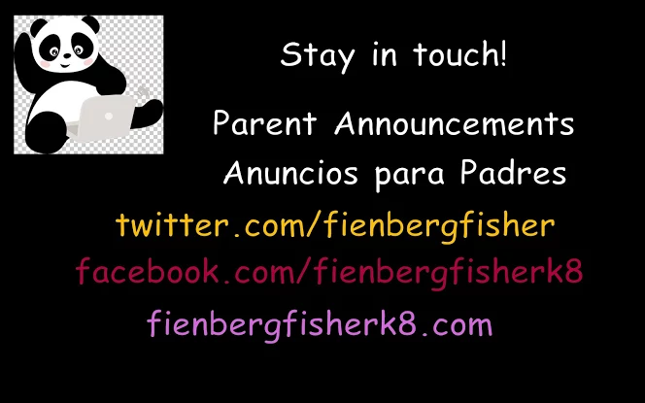

Slide 38


Thank you! We hope you that together we have a wonderful and productive 2015-2016 school year!

